Slide 1
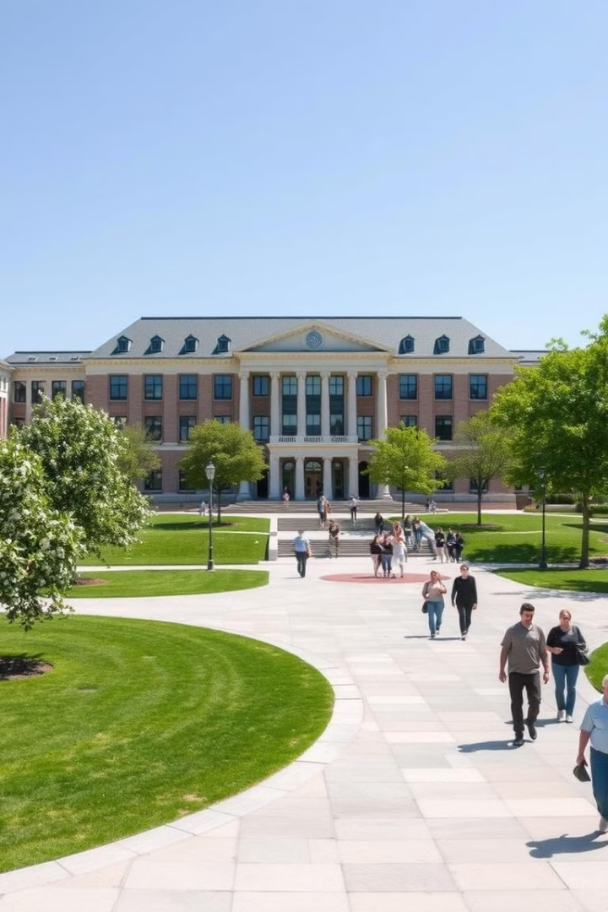
Student Housing Management System
Outlines our project Student Housing Management System, designed to streamline the housing process for students, landlords, and university administrators.
By Team 72
DEEPAK KUMARAN THOPPUDU SUDHARSANAN - 002050934
SNEGHASHREE THANGARAJU - 002050508
SHREE NITHYA SARVEPALLI - 002304058

Slide 2
The Challenge: Student Housing
Finding suitable student housing near universities is a challenge. Students struggle to discover affordable accommodations with the required amenities while balancing academic responsibilities.
Student Perspective
Landlord Perspective
Limited time, balancing studies, seeking affordable, convenient options.
Managing listings, connecting with tenants, scheduling tours, navigating inefficiencies.

Slide 3
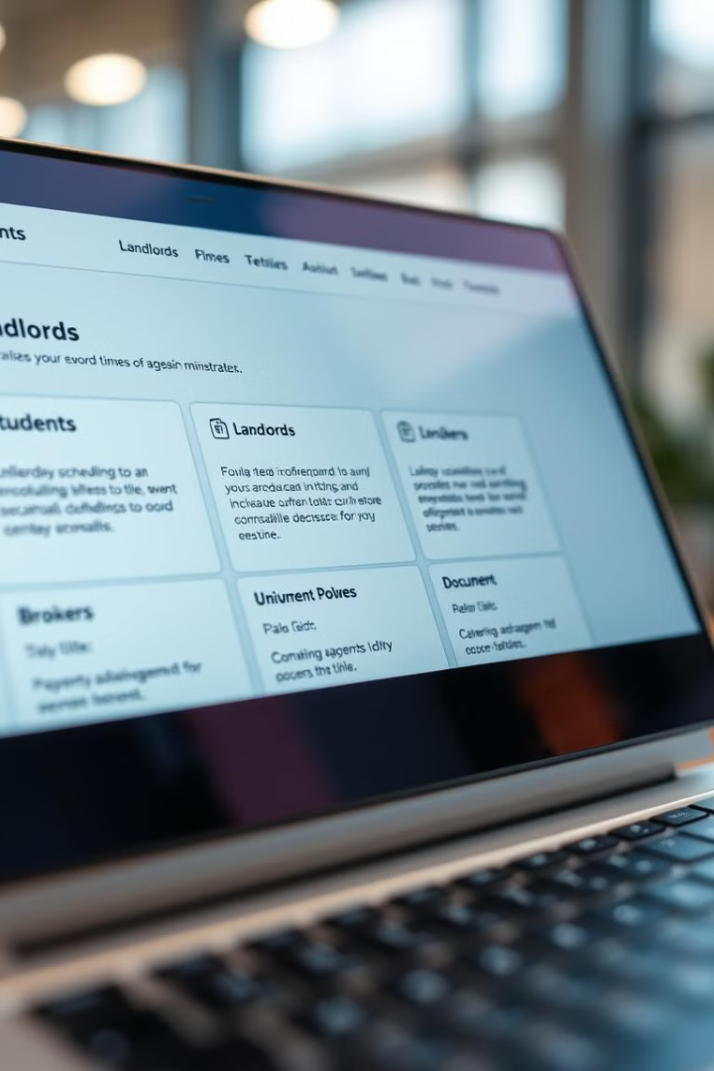
Our Solution: A Comprehensive System
The Student Housing Management System is designed to bridge the gap between students, landlords, brokers, and university administrators.
Students
Landlords & Brokers
View listings, schedule tours, report issues, access marketplace.
Manage listings, respond to student requests, streamline operations.
University Admins
Manage student records, provide support for housing and marketplace.

Slide 4

System Architecture: A Visual Overview
The system's architecture is based on a multi-tiered approach, incorporating various components and functionalities to achieve seamless operation.

Slide 5




The Ecosystem: Roles and Organizations
The system operates across diverse roles and organizations, fostering collaboration and streamlining operations.
Students
Brokers
Landlords
University Admins
View listings, book appointments, report issues, use the marketplace.
Manage listings, handle student appointments.
Own and manage apartment listings.
Oversee housing operations and student records.

Slide 6
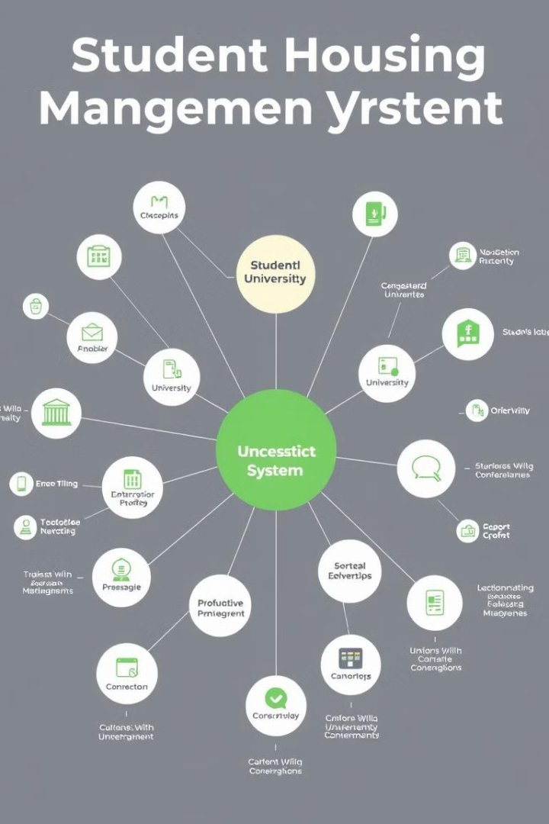
Expanding the Ecosystem: Enterprises and Networks
The platform operates across diverse enterprises and networks, facilitating a seamless and integrated experience.
Educational Institutions
Real Estate Firms
Collaborate to provide properties and manage listings.
Partner with the platform to assist students with housing.
Tech Support Companies
Marketplace Providers
Facilitate student transactions for essential goods.
Handle platform-related issues and ensure smooth operations.

Slide 7

Key Use Cases: Simplifying the Housing Process
The system provides a range of functionalities designed to improve the student housing experience.
1
2
3
4
View Listings
Schedule Appointments
Report Issues
Marketplace Operations
Students browse listings based on apartment type and location.
Students book house tours or broker meetings. Brokers and landlords approve or deny requests.
Students report problems with housing or appointments. Tech support resolves issues and updates statuses.
Students list products for sale. Other students view and purchase listed items.

Slide 8





System Benefits: Streamlining and Efficiency
The Student Housing Management System offers numerous benefits for all stakeholders.
1
Improved Efficiency
2
Reduced Costs
3
Enhanced Transparency
4
Improved Communication
5
Greater Satisfaction

Slide 9
Next Steps: Implementation and Rollout
We are excited to implement this system and provide a valuable solution for the student housing community.
1
System Development
2
Pilot Testing
3
System Launch
4
Continuous Improvement

Slide 10

Conclusion: A Vision for the Future
The Student Housing Management System holds the potential to revolutionize the student housing experience, fostering a more efficient and collaborative environment.

Slide 11
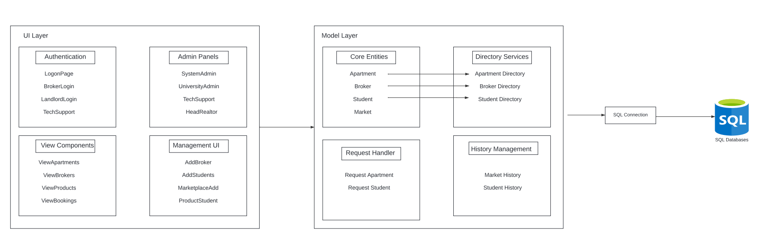
High Level Diagram and UML Class Diagrams

Slide 12
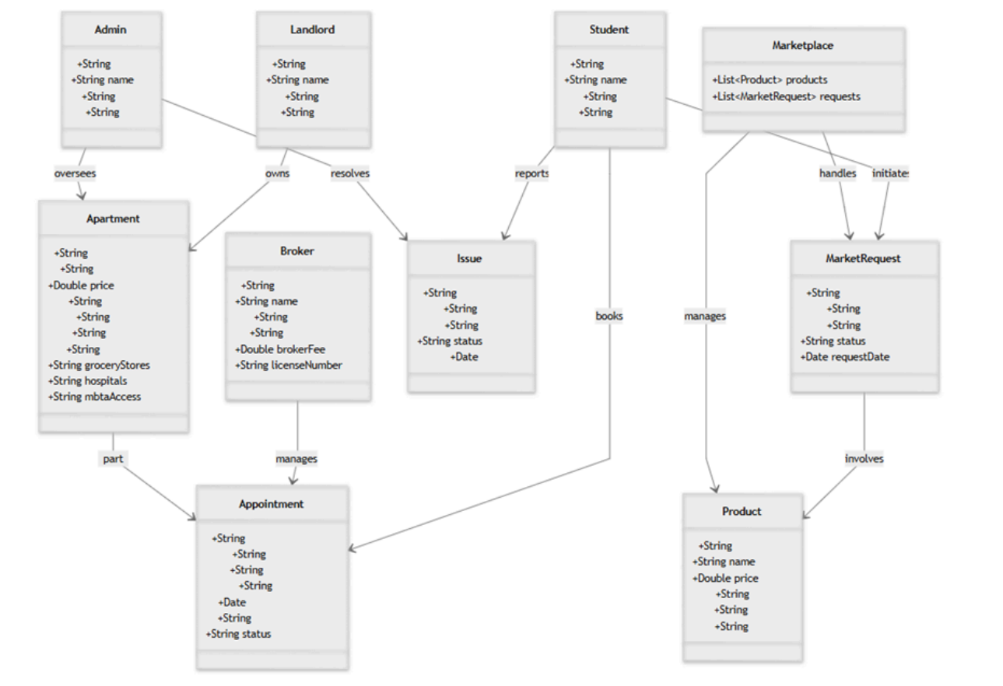

Slide 13
